Slide 1



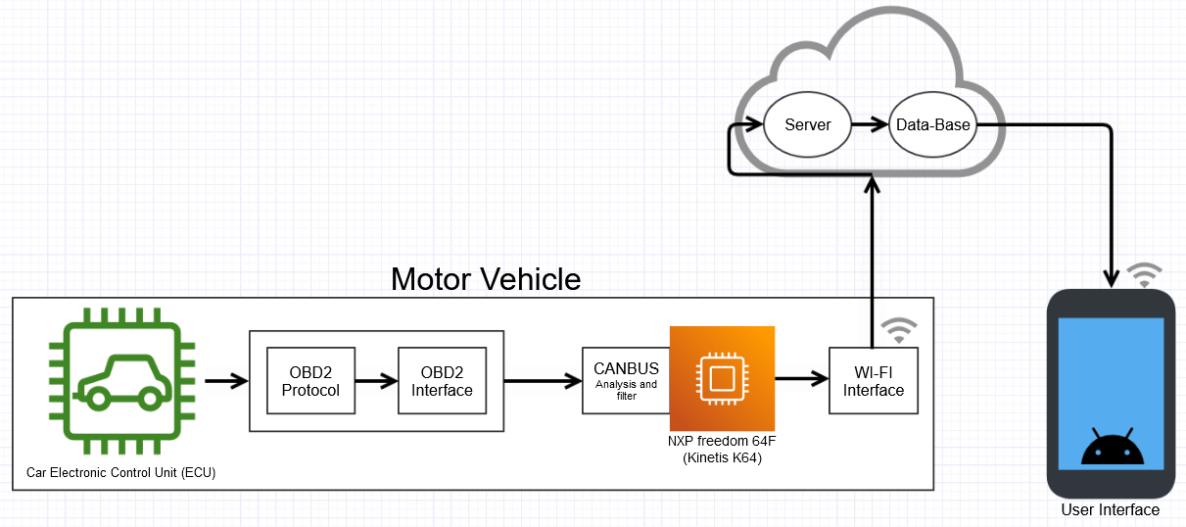
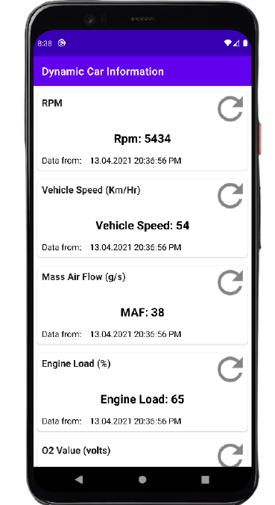
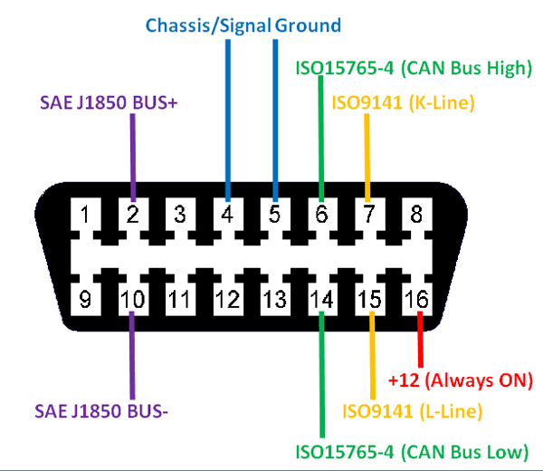


Dynamic Car Information
Sean O’Shaughnessy
Bachelor of Engineering (Honours) in Software and Electronic Engineering
Ever wanted to monitor important information from your car without being in it?
Technologies:
Can Bus
AWS
OBD
Free RTOS
Hardware:
NXP Freedom 64F
Multiple Protocol OBD Ecu Simulator
Wi-Fi Interface chip
Mobile Phone (Android)
Results:
Project Summary:
Important information such as RPM, oil pressure, oil temperature can be measured from a vehicle’s ECU (Electronic Control Unit) that will allow the user to monitor the vehicle without being in the vehicle. This can also aid fleet owners to monitor their trucks or vehicles on the go and be aware of any foul play to their property.
Department of
Electronic and
Electrical Engineering

